Slide 1

Server and Systems Administration Module Code : CSC3504
Simeon NDAYAMBAJE
Server and Systems Administration , CSC3504
1

Slide 2
Chapter 5
Security Principals

Slide 3
What Server and System Security?
Server and System security is the protection of assets (computer systems, networks, and data) from unauthorized access, use, alteration, or destruction.

Slide 4
Essential Dimensions for Server Security
Integrity: prevention against unauthorized data modification
Nonrepudiation: prevention against any one party from reneging on an agreement after the fact
Authenticity: authentication of data source
Confidentiality: protection against unauthorized data disclosure
Privacy: protection of individual rights to non-disclosure
Availability: prevention against data delays or removal
Auditability: Data should be recorded in such a way that it can be audited for integrity requirements.
Encryption: Information should be encrypted and decrypted only by an authorized user.

Slide 5
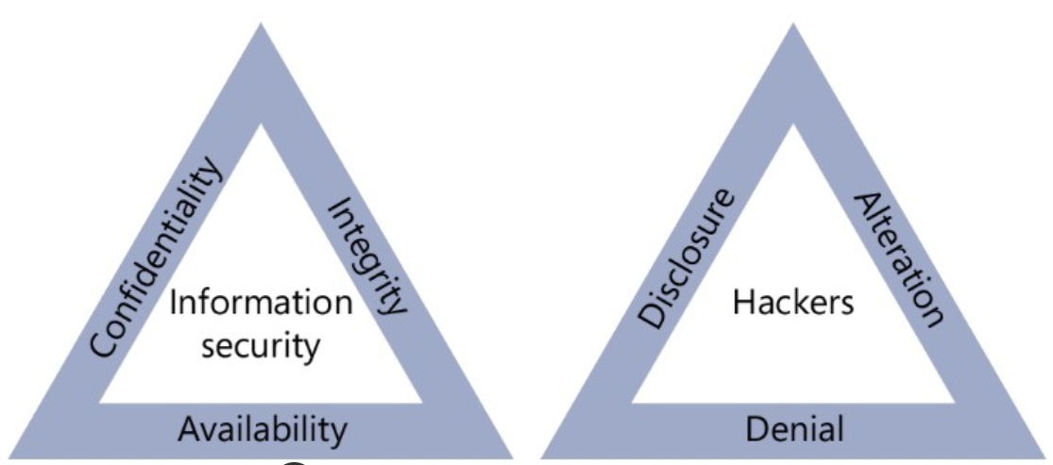
CIA and DAD
CIA Triad –
Goals for implementing
What can we do?
DAD Triad –
What can we avoid

Slide 6
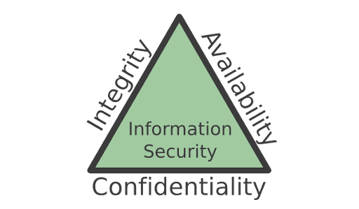
Cyber Security Goals (CIA Triad)
The objective of Cybersecurity is to protect information from being stolen, compromised or attacked.
Cybersecurity can be measured by at least one of three goals-
Protect the confidentiality of data.
Preserve the integrity of data.
Promote the availability of data for authorized users.

Slide 7
CIA Triad
Confidentiality – confidentiality Mechanism ensure that Confidential information(eg: Username, Password, Pin Number,..) should not be accessible to unauthorized users.
Integrity – Integrity mechanism ensure that Data may only be modified through an authorized mechanism.(from Database repository or During Transmission)
Availability – Authorized users should be able to access data on time in case is needed.

Slide 8
Confidentiality models
Confidentiality can be archived by implementing the following security mechanisms:
usernames, passwords,
access control lists (ACLs),
encryption.

Slide 9
Integrity models
Integrity models have three goals:
Prevent unauthorized users from making modifications to data or programs
Prevent authorized users from making improper or unauthorized modifications
Maintain internal and external consistency of data and programs

Slide 10
Integrity models
Integrity can be archived by implementing the following security mechanisms:
Data encryption
Digital Signatures
Certificates
Non-repudiation

Slide 11
Availability Models
Availability models keep data and resources available for authorized use, especially during emergencies or disasters.
Three common challenges to availability:
Denial of service (DoS)
Loss of information system capabilities because of natural disasters (fires, floods, storms, or earthquakes) or human actions (bombs or strikes)
Equipment failures during normal use

Slide 12
Availability Models
Availability can be archived by implementing the following security mechanisms:
Processes such as
redundancy,
failover,
RAID
high-availability clusters
it is implemented using methods such as
hardware maintenance,
software patching
network optimization.

Slide 13
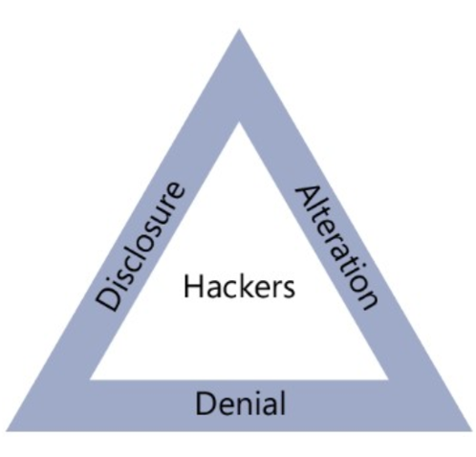
DAD Triad

Slide 14
DAD Triad
Disclosure – Unauthorized individuals gain access to confidential information and use it to disclosure purpose.
Alteration – Data is modified through some unauthorized mechanism by unauthorized users.
Denial – Authorized users cannot gain access to a system for legitimate purposes.

Slide 15
Threats
What is Threats?
is anyone (foreign or domestic, internal or external, Terrorists, insiders, employees, hackers state-sponsored or a single element) with the capability, technology, opportunity, and intent to do harm or interrupt the system functionality is threats.

Slide 16
Why do we need client security?
If client left open or not secured, provide entry points for hackers and other unauthorized user to manipulate the system.
Unauthorized software, Virus will infect files and Network operating system

Slide 17
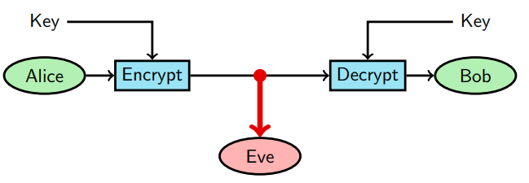
Cryptography
What is “Cryptography”? is a Greek word that means “hidden writing”
Used to hide message from someone, and sometimes prevent them from creating a new message

Slide 18
Encryption & Decryption
Encryption means translate Plain text Into cipher text
Decryption means translate cipher text Into Plain text

Slide 19
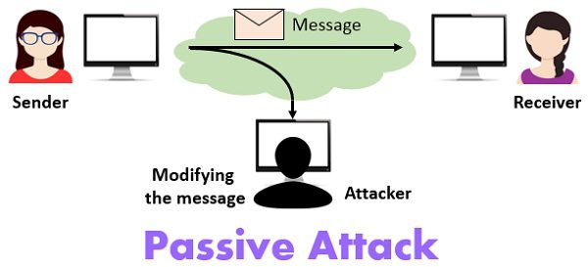
Types of network security attacks
Passive attack: In this attack an adversary deploys a sniffer tool and waits for sensitive information to be captured.
Passive attacks attempt to steal or monitor sensitive data.
This information can be used without the knowledge of the user.
Notes:
Passive attack: In this attack an adversary deploys a sniffer tool, traffic analysis software, filtering clear text passwords from unencrypted traffic and waits for sensitive information to be captured. This information can be used for other types of attacks. Once an adversary found any sensitive or authentication information, he will use that without the knowledge of the user.

Slide 20
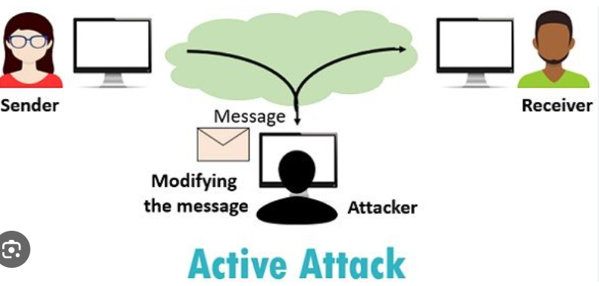
Types of network security attacks
Active Attack: Active attacks attempt to modify, destroy or disrupt network or system resources.
It results in disclosing sensitive information, modification of data or complete data lost.
Notes:
Passive attack: In this attack an adversary deploys a sniffer tool, traffic analysis software, filtering clear text passwords from unencrypted traffic and waits for sensitive information to be captured. This information can be used for other types of attacks. Once an adversary found any sensitive or authentication information, he will use that without the knowledge of the user.

Slide 21
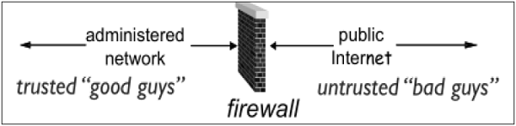
What is Firewalls
Firewall is a network device that isolates organization’s internal network from larger outside network/Internet. It can be a hardware, software, or combined system that prevents unauthorized access to or from internal network.
Notes:
Passive attack: In this attack an adversary deploys a sniffer tool, traffic analysis software, filtering clear text passwords from unencrypted traffic and waits for sensitive information to be captured. This information can be used for other types of attacks. Once an adversary found any sensitive or authentication information, he will use that without the knowledge of the user.

Slide 22
Hardware threat

Slide 23
Hardware threat
Hardware threats involve four types of threats: -
Physical
Electrical
Environmental
Maintenance

Slide 24
Hardware threat
Physical Problems:
Improper installation, selecting wrong components, incomplete devices, lack of knowledge, unsecure or less secure network components
Measurement should be taken (Solutions)
Always purchase branded and genuine components.
Hire experienced and knowledgeable technical staff.
Always remove console cable after use.
Always log off from administrative interfaces before leaving a station.
Critical resources should be kept in secured room or location

Slide 25
Hardware threat
2. Electrical
Irregular power supply (fluctuations, high voltage, low voltage or surge voltage) can cause serious damage to the network components.
Precautions(Solution)
Use UPS (Uninterruptible Power Supply) for critical network resources.
Use RPS (Redundant power supplies) for critical devices.
Use backup generator systems with auto inverter technology that switches on backup power supply automatically if main supply went down.
Use monitor and alarm system at device levels.

Slide 26
Environmental
3. Environmental
Extreme weather conditions (such as moisture, very high or low temperature and humidity) can also damage network devices.
Action(Solution) should be taken:-
keep away EMI (Electro Magnetic Interface) devices from critical networking devices such as routers, switches, PCs and Servers.
Maintain room temperature and humidity parameters.
The ideal temperature for servers to run efficiently is between 19 – 21°C.
Temperatures below 10°C or above 35°C need to be addressed immediately.
The humidity level should be between 40 – 60%.
Keep the critical networking devices away from direct sun light and heavy winds.

Slide 27
Maintenance threat
4. Maintenance
this threats includes lack of spare parts, poor cabling, incorrect or no labeling on components.
Following guideline(Solutions) should be taken:-
Clearly label all components.
Secure cabling equipment in racks.
Always maintain a sufficient stock of critical spare parts for emergency use.

Slide 28
HOW TO MINIMIZE SECURITY THREATS
1. Perform a risk assessment:
2. Develop a security policy: written statement on:
What assets to protect from whom?
Why these assets are being protected?
Who is responsible for what protection?
Which behaviors are acceptable and unacceptable?
3. Develop an implementation plan:
4. Create a security organization policy
5. Perform a security audit:

Slide 29
Control Access to the Server:
Remove, disable or change passwords to default accounts.
All passwords should be strong; unique, and changed periodically.
Disable "guest" accounts/access.
Review user accounts and remove inactive accounts.
Keep a complete list of everyone who has access to the server, and their privileges (read/write/Execute).
No open file-sharing is allowed.
All remote access should be restricted to specific IP addresses, and encrypted from end to end (via VPN).

Slide 30
Thank you

